Slide 1
Primary Mathletes Interim Presentation
Paul Davis C16324311
DT282

Slide 2
Project Idea
Create an application to be used by Primary School teachers and students learning maths.
Improve retention of information for the students outside of class.
Create an application that young students will want to use (User Experience).

Slide 3
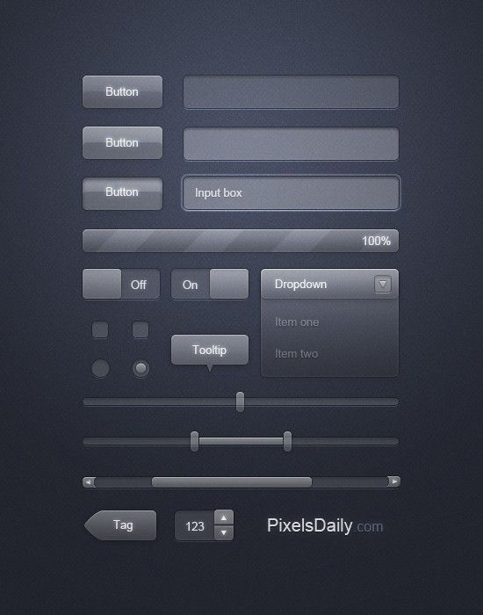
Research
Mobile Devices > Computers
High Quality User Interfaces:
Colour
Sound
Touch Feedback

Slide 4
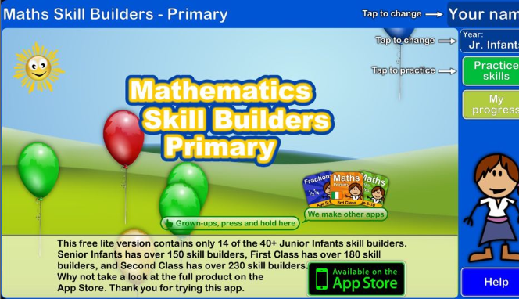
Research
Poor Quality User Interfaces
Outdated Information

Slide 5





Technology Used
Python, PyCharm
Firebase Database
Kivy Library
Android Phone
iOS Phone
Windows 10 Laptop

Slide 6
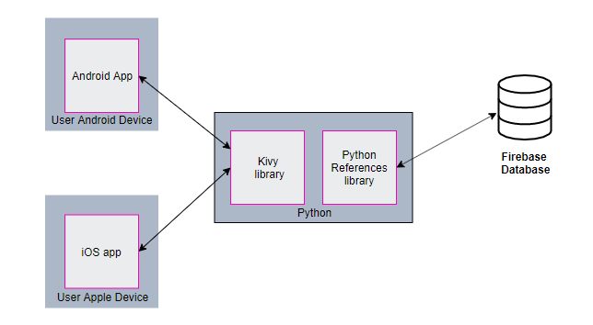
System Design
Architecture

Slide 7
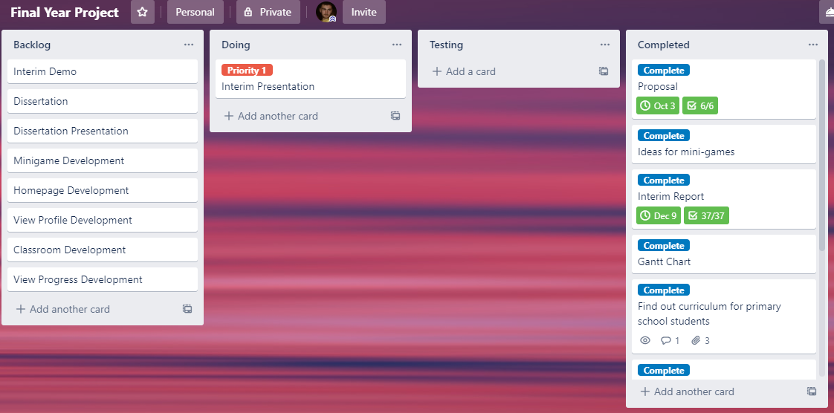
System Design
Project Management Methodology

Slide 8
Project Complexity
Creating a user-friendly application suitable for students and teachers.
Implement correct curriculum for 2nd class primary school students.
Keeping minigames interesting with suitable educational content

Slide 9
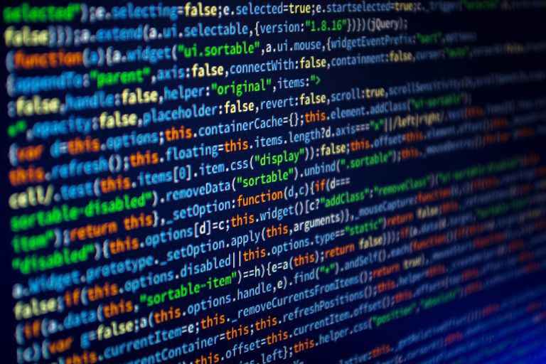
Demo
Connection between Middle-Tier and Back-End
Examples of Kivy created GUI
First iteration of authentication loops

Slide 10
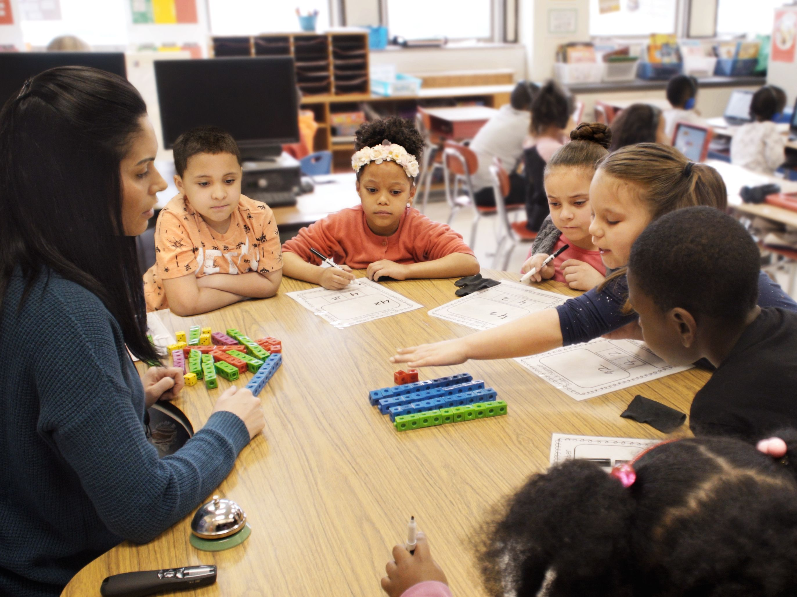
Testing
Small focus group
Or
Testing with young people

Slide 11
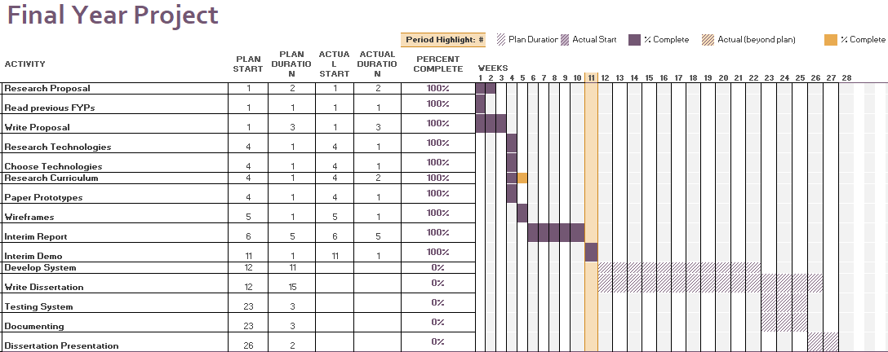
Future Work

Slide 12
Future Work
Increase efficiency of data retrieval from database
Implement minigames
Flesh out profile, classroom and progression pages

Slide 13

Questions

Slide 14
My Github Link: https://github.com/paulpdavis3/FYP

Slide 15
References
Questions: https://www.orangehilldev.com/9-questions-you-should-ask-web-development-agency-before-building-a-web-site/
Fun interface: http://cgis.cs.umd.edu/~ben/Fun-p48-shneiderman.pdf
Good UI: https://www.pinterest.ie/pin/144255994286276123/?lp=true
Kivy logo: https://kivy.org/#home
Python logo: https://www.python.org/community/logos/
Fireabse logo: https://firebase.google.com/brand-guidelines
iOS logo: apple.com
Small focus group image: https://www.pinterest.ie/pin/496099715203727468/?lp=true

